Slide 1
Working with models and strongly-typed views
SERVER-SIDE WEB DEVELOPMENT
ASP.NET Core MVC

Slide 2

Agenda
Defining Models
The Entity Framework
Validating Model Data
Demo – BMI Calculator

Slide 3

The Model
In MVC the M stands for Model, being one of the most important components of the application:
  The model is the representation of the real-world objects, process, and rules that define the subject of interest (the domain) of our application
  The model (A.K.A: The DOMAIN MODEL) contains the C# objects that make up the application and the methods that let us manipulate them
  The views and controllers then expose the domain to our clients in a consistent manner
  When you are working with data from a database, you may start with models as the focal point and then add the controllers and views
  Basic Models are simply POCOs (Plain Old C# Objects) – nothing more.

Slide 4
DEFINING MODELS
What you need to know

Slide 5

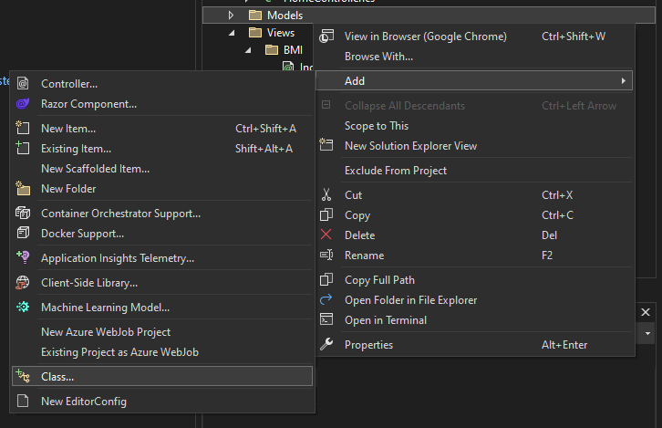
Adding a Model Class
Model classes are contained directly within the Project \Models\ Folder (or a sub-folder)
Adding a new Model can be performed by right-clicking Models and selecting:
ADD ▶ CLASS

Slide 6
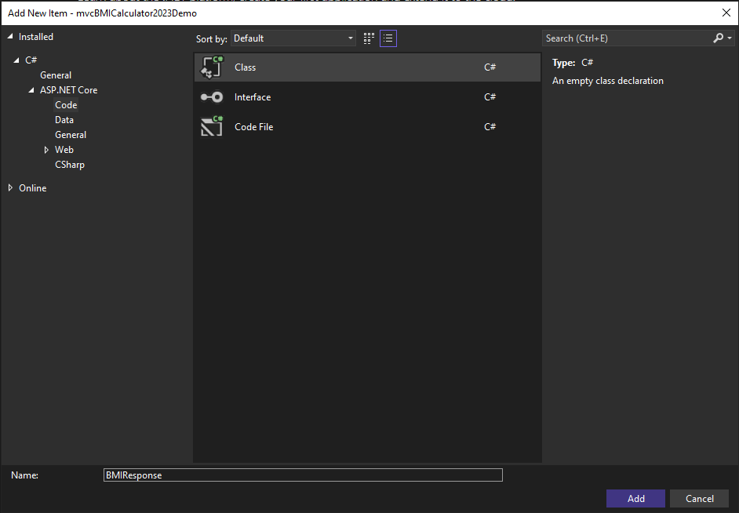
Implementing Model Classes
Choose a name for your class that adheres to C# Naming Conventions
- Click ADD
Once your Class has been added to your Project, begin adding new model properties as you would a normal class.
Many Model classes are eventually mapped to the Data Model of a Database, within specific Tables/Fields.
* This model will not be synchronized to a DB, but this we will add that functionality within project(s) in the near future.
Working with models

Slide 7
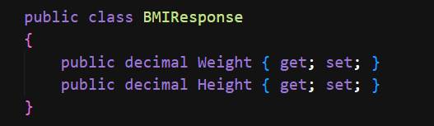
EXAMPLE #1 (BMIResponse)

Slide 8
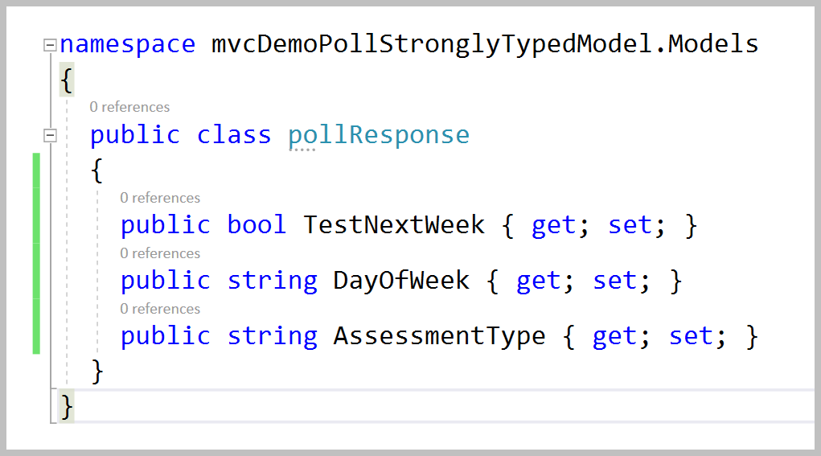
EXAMPLE #2 (PollResponseModel)

Slide 9
The entity framework
Our path forward for data-centric development

Slide 10
Introduction to the Entity Framework
The Entity Framework Core (EF Core) is one of components available within .NET and allows us to access a database using strongly typed code (with C#, F# and Visual Basic)
When leveraging classes that are integrated to use EF Core, you don’t have to worry about the Low-Level abstractions of Data Management:
  No managing SQLConnections, SQLCommands, SQLParameters, DataSets, etc.
  We will work directly with C# code and utilize LINQ
  LINQ (Language INtegrated Query : pronounced "link") is another Microsoft .NET component that adds native data querying capabilities to .NET languages and objects.
  We will be using EF Core with the Code First Approach to creating MVC data-centric applications

Slide 11





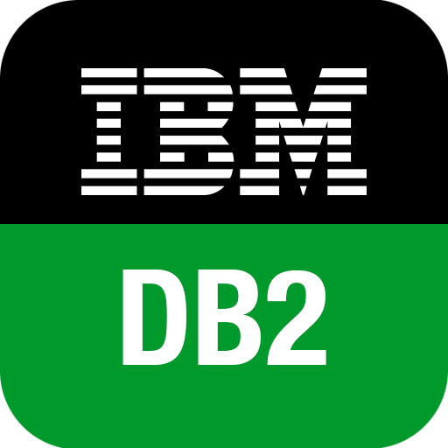






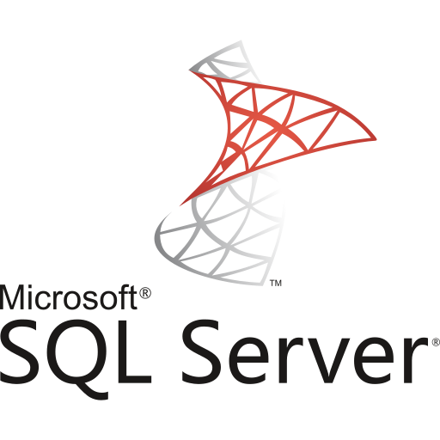
DATABASE SUPPORT FOR EF Core
There is a great amount of support for many popular database platforms, which include:
Microsoft SQL Server
Oracle
IBM DB2
PostgreSQL
and others depicted within this slide

Slide 12

EF Core vs EF 6
Recall that there are 2 different version of ASP.NET contained within .NET:
ASP.NET (from the .NET Framework)
ASP.NET Core (from .NET Core)
There are separate version of the Entity Framework for each:
Entity Framework v6 is a legacy component only meant to be used with ASP.NET (.NET Framework) and legacy applications.
Entity Framework Core is a newer component that is only meant to be used with ASP.NET Core projects, etc.
ONLY USE ENTITY FRAMEWORK CORE

Slide 13
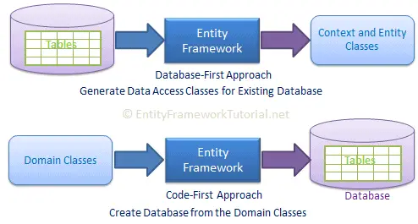
Approaches to using Entity Framework
The EF Core has two different approaches to utilizing it within .NET Applications:
The Database-First Approach
The Code-First Approach

Slide 14
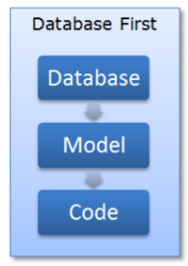
The
Database First Approach
  (Also known as Schema First Approach)
  This allows us to leverage an existing database implementation and generate the Model classes and supporting configuration based upon this physical database and the schema.

Slide 15
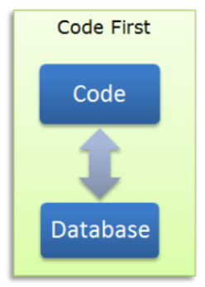
The
Code-First Approach
  In this approach you write your C# model classes first and the EF can generate a DB for use on the fly based upon these class definitions or it can map your classes to an existing DB either using Conventions (Naming Conventions)
  Or using C# code you can provide an explicit mapping from a property on an object to a column that is in a DB table
  The Code First approach is the one that is the most widely embraced by developers and industry
(We will be predominantly using the Code-First Approach)

Slide 16
Validating model data
in ASP.NET Core

Slide 17
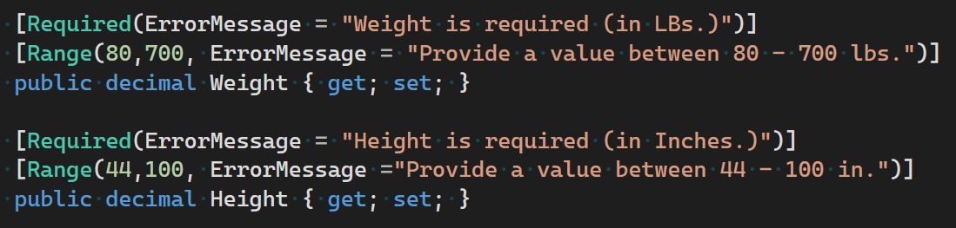
Using Data Annotations for Validation
Many forms of Model Validation are implemented directly within the model class, using Data Annotations.
You will need a using statement for System.ComponentModel.DataAnnotations in order to use these validations
Note the validations are implemented directly above the properties they are applied to via special attributes:

Slide 18

INTRODUCTION TO VIEW HELPER METHODS
The MVC Framework comes with a collection of built-in helper methods that are convenient for rendering HTML links, text inputs, checkboxes, selection menus, and even custom controls
You can use HTML helpers within a view to render HTML content. An HTML helper, in most cases, is just a method that returns a string.
You can build an entire ASP.NET MVC application without using a single HTML helper. However, HTML helpers make your life as a developer easier. By taking advantage of helpers, you can build your views with far less work.

Slide 19
Form Helpers
There are several HTML helpers that you can use to render HTML form elements:
  Html.ActionLink()
  Html.BeginForm()
  Html.TextBoxFor()
  Html.TextAreaFor()
  Html.DropDownListFor()
  Html.CheckboxFor()
  Html.RadioButtonFor()
  Html.ListBoxFor()
  Html.PasswordFor()
  Html.HiddenFor()
  Html.LabelFor()
  Html.EditorFor()
  Html.ValidationSummary()
There are also equivalent form helpers for working with views that are not strongly typed, or non-model information.
For example: Html.TextBox()

Slide 20
The ActionLink Helper
The easiest way to render an HTML link in a view is to use the HTML.ActionLink() helper. The Html.ActionLink() does not link to a view.
  Instead, you use the Html.ActionLink() helper to create a link to a controller action.
The ActionLink(…) method has several separate signatures with differing parameters to choose from, as it is an overloaded method.
In the following example: the first is the text to display in the link and the second is the controller action to perform when the user clicks the link
Example:
You can also pass route values from an Html.ActionLink() to a controller action.
For example, you might need to pass the Id of a database record that you want to edit. Here’s how you pass an Id parameter to the Edit() action:
When that action link is rendered in the browser , it creates a link like this:

Slide 21
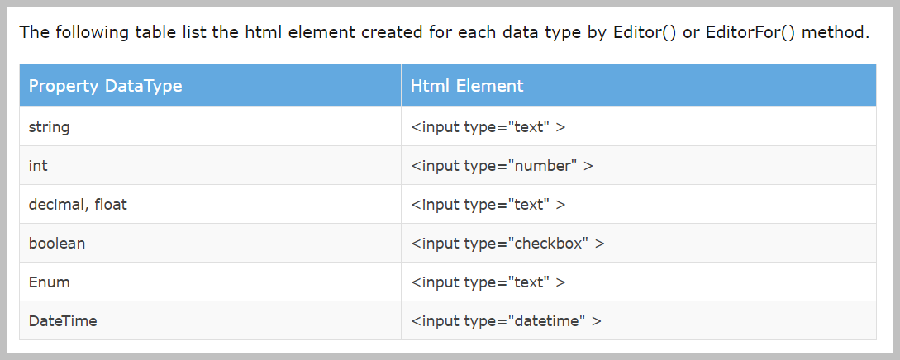
EditorFor
(By Datatype)
This method will render different html controls depending on the model property’s datatype

Slide 22
Deeper View of a select few HTML Helpers
Html.BeginForm()
  Writes a <form> tag into the response. When the form is submitted the request will be processed by an action method
Html.ValidationSummary()
  Returns an unordered list of validation messages that are in the modelState Dictionary object when using DataAnnotations (model validation helpers)
Html.TextBoxFor()
  Used in strongly typed views when you want to display content from a model in a textbox

Slide 23
DEMO
The BMI Calculator

Slide 24
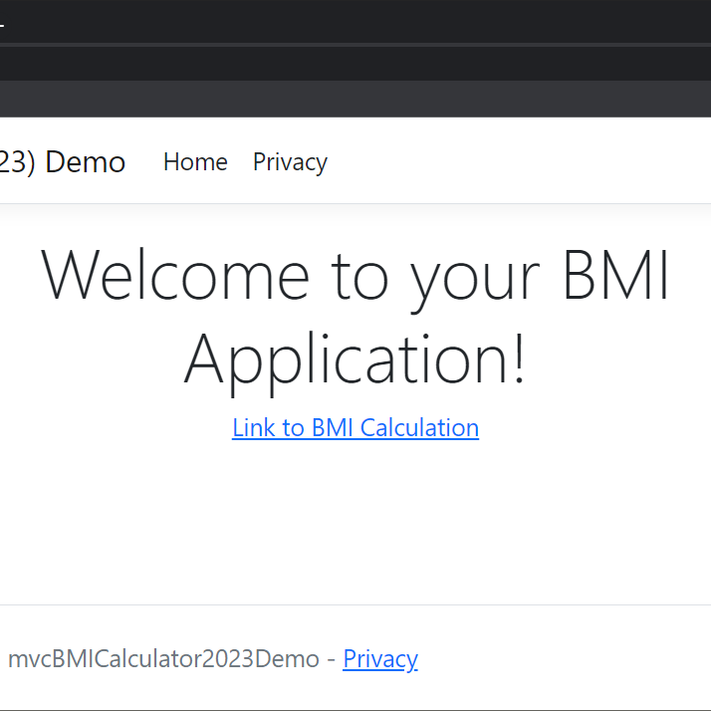
Building our App
There are a series of Implementation videos that will show you step-by-step how to create our demo for BMI Calculator.
Each of the videos will focus on completion of one of the components, while showing how they will incrementally integrate.
Before beginning the implementation, refer to the solution video within the next slide to see the application behaviour

Slide 25
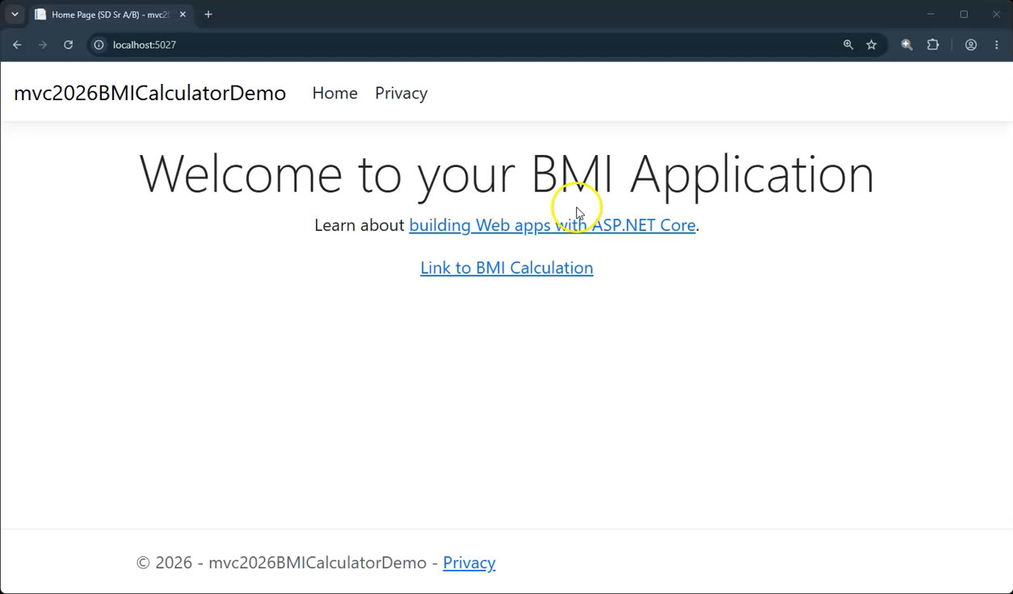
SOLUTION Video
(BMI Calculator)

